Slide 1

Hostel Management System using C++

Slide 2
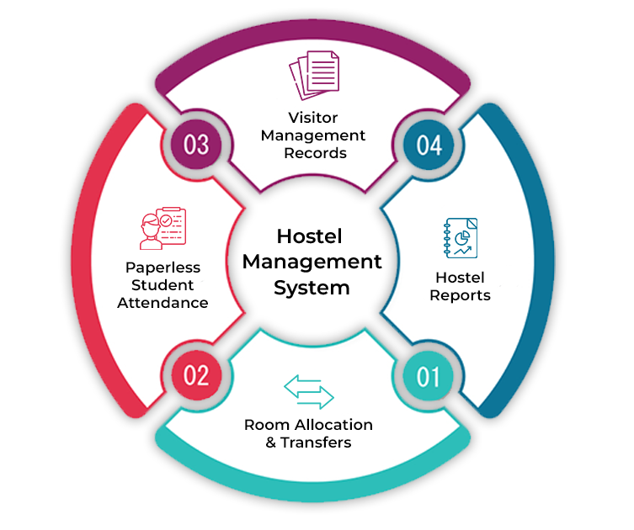
01
ABSTRACT
The sole intention behind the consideration of this project is to generate and manage manual record keeping of the hostel to an automated form.
It manages all the information related to the student’s registration, room preference/allocation, attendance etc.
It is built for reducing manual work and easy hostel management.

Slide 3
TABLE OF CONTENTS
01
ABSTRACT
05
RESULT
02
INTRODUCTION
06
RESEARCH PAPER
03
METHODOLOGY
07
CONCLUSION
04
FORM OF JOURNAL
08
REFERENCES

Slide 4

02
The hostel management system tackles the challenges of manual record-keeping by offering an automated solution. Students can be registered electronically, capturing essential details like name and registration number. The system then simplifies room allocation, keeping track of bed availability and assigning rooms based on student preference. It also keeps track of student details, bed availability, and attendance records, all in one place. By eliminating manual processes, the system reduces errors and saves valuable time for hostel staff.
INTRODUCTION

Slide 5
The hostel management system is a software solution designed to streamline the management of hostel facilities in educational institutions. With the increasing complexity of hostel operations and the growing number of students residing in hostels, there arises a need for an efficient system to manage student registrations, room allocations, attendance tracking, and other hostel-related tasks. The hostel management system aims to address these challenges by providing administrators with a user-friendly platform to manage hostel operations effectively.
03
Methodology

Slide 6
OBJECTIVES
Efficient registration process -
Simplify the registration process for new hostel residents by automating data entry and registration procedures.
Room allocation -
Facilitate the allocation of hostel rooms to students based on their preferences and availability.
Attendance tracking -
Enable administrators to track student attendance and monitor hostel occupancy in real-time.
Student Management -
Provide comprehensive student management features, including adding, removing, and updating student records.
User friendly interface -
Develop an intuitive and user-friendly interface for both administrators and hostel residents to interact with the system
seamlessly.

Slide 7

SYSTEM REQUIREMENTS
Software requirements
Hardware requirements

Slide 8
Existing system
The existing system is manual based and need lot of efforts and consume enough time. In the existing system we can apply for the hostels online but the allotment processes are done manually. It may lead to corruptions in the allocation process as well as hostel fee calculation. The existing system does not deal with mess calculation and complaint
Proposed system
The proposed system aims at developing a system for keeping records and showing information about or in a hostel. This system will help the hostel officer to be able to manage the affairs of the hostel. It will show rooms available or not and number of people in a particular room. It also records the attendance, and various updates of a student.

Slide 9
Implementation
Class Definition: The program defines a class named ‘Hostel’, encapsulating the functionality related to hostel management. This class includes private member variables such as ‘name’,’ regNumber’, ‘bedType’, ‘isPresent’, and ‘bedno’, along with member functions to perform various operations.
Constructor: The ‘Hostel’ class constructor is defined to initialize the hostel data, including student name, registration number, bed type, presence status, and bed number.
Functionality Implementation: allocateRoom, bedStatus, add, remove, display, markAttendance, isAttendanceMarked, getBedType.
Main Function: Includes - User Interface, Menu Options, Switch Case, System Clearing
Looping Structure: The main function is structured within a while (true) loop, allowing users to perform multiple operations until they choose to exit the program.
Input Handling: User input for choices, student information, registration numbers, and bed types is handled using cin statements, ensuring interaction with the program.

Slide 10
FORM OF JOURNAL
04

Slide 11
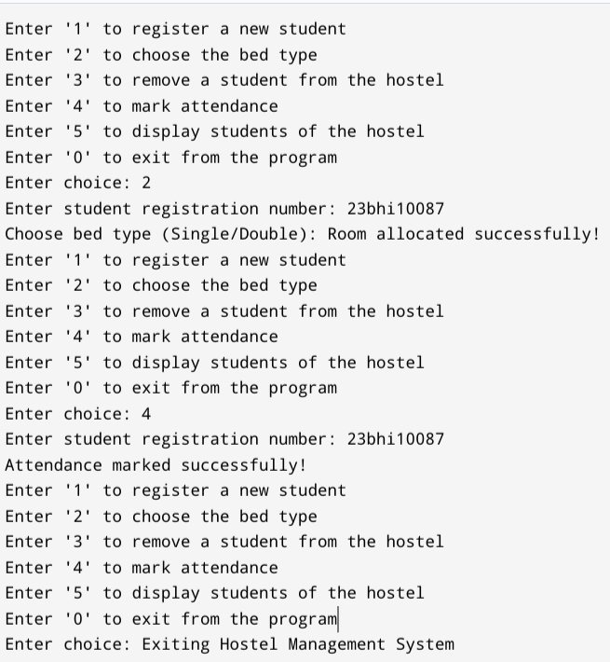
Sample output :
05
RESULT

Slide 12
RESEARCH PAPER
06

Slide 13
CONCLUSION
07
The expanded functionality of today’s software requires an appropriate approach towards software development. This hostel management software is designed for people who want to manage various activities in the hostel. For the past few years the number of educational institutions are increasing rapidly.
Thereby the number of hostels are also increasing for the accommodation of the students studying in this institution. And hence there is a lot of strain on the people who are running the hostel and software’s are not
usually used in this context. This particular project deals with the problems on managing a hostel and avoids
the problems which occur when carried manually.

Slide 14
REFERENCES
08

Slide 15
10
THANKYOU

